Slide 1
CRISISaID-DISASTER MANAGEMENT APP
GUIDE: DR.M.S.VINMATHI,M.E.,Ph.D.,
SUPERVISOR
ASSOCIATE PROFESSOR
BY
BATCH – 04
PRATEEKA K K (2022PECCS239)

Slide 2
ABSTRACT
Disaster preparedness and response have become crucial in mitigating the effects of natural calamities on vulnerable populations. CrisisAid is a comprehensive mobile application designed to enhance disaster management efforts by providing real-time weather predictions, early warning alerts, and crucial resource access. By leveraging cutting-edge geolocation and data integration technologies, the app offers timely notifications for disasters like storms, floods, and earthquakes, enabling communities to take preventive actions. Additionally, CrisisAid facilitates access to nearby shelters, medical services, and support networks through its resource mapping and crowdsourcing features. Users can contribute real-time reports on disaster impacts, helping authorities and NGOs allocate resources more efficiently. This report outlines the design, features, and implementation of CrisisAid, emphasizing its potential to improve disaster preparedness, response, and recovery by fostering community resilience and enhancing coordination efforts.

Slide 3
introduction
The CrisisAid app is a comprehensive solution designed to enhance disaster preparedness and response through advanced technology and community engagement. With increasing frequency and intensity of natural disasters, the need for timely information and effective communication has never been more critical. CrisisAid addresses this pressing need by providing users with real-time weather predictions, localized early warning alerts, and easy access to essential resources such as shelters and medical facilities. By integrating community reporting and support services, CrisisAid empowers individuals and organizations to collaborate effectively during emergencies, ultimately aiming to reduce the impact of disasters on lives and property. This app is not only a tool for information dissemination but also a platform for building resilience and fostering a proactive approach to disaster management.

Slide 4
Existing system
Several existing disaster management applications aim to enhance public safety during emergencies. The FEMA Disaster App provides alerts and safety tips but often suffers from delayed notifications. The Red Cross Emergency App offers local shelter information but lacks adequate localization for immediate threats. Similarly, the Disaster Alert app aggregates global disaster data but struggles with resource mapping, complicating access to nearby services. While apps like MyShake provide earthquake alerts, they often miss community reporting features that enhance situational awareness. Despite their functionalities, these systems typically present complex interfaces that hinder user experience and rely on static content, failing to deliver real-time updates. These limitations underscore the need for a more integrated and user-friendly solution like CrisisAid.

Slide 5
Proposed SYSTEM
The proposed CrisisAid app aims to enhance disaster management through a user-friendly platform that delivers real-time information and community support. Key features include advanced weather predictions and localized early warning notifications, ensuring users receive timely alerts based on their specific locations.
Additionally, CrisisAid connects users to nearby shelters, food distribution centers, and medical facilities through a mapping feature. The app also encourages community reporting, allowing users to share updates on their situations, which helps authorities assess needs and fosters collaboration during emergencies. Overall, CrisisAid significantly improves disaster response efforts.

Slide 6
DEVELOPMENT ENVIRONMENT
SOFTWARE REQUIREMENT :
Programming Language : Java
Development Environment: Android Studio
Operating System
Database : Firebase
Accessibility Feature

Slide 7
HARDWARE REQUIREMENT :
Mobile Device
Internet Connectivity
Audio Output
GPS Module.

Slide 8
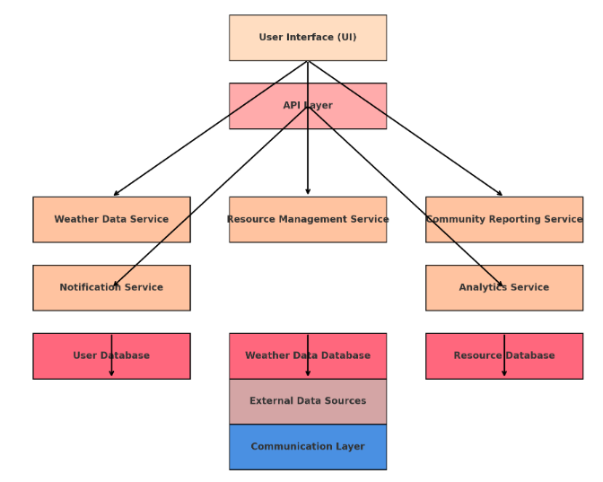
SYSTEM ARCHITECTURE DIAGRAM

Slide 9
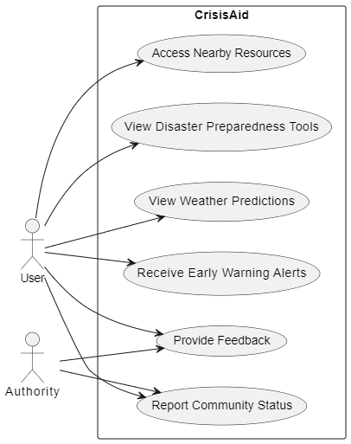
UML DIAGRAMs USE CASE DIAGRAM

Slide 10
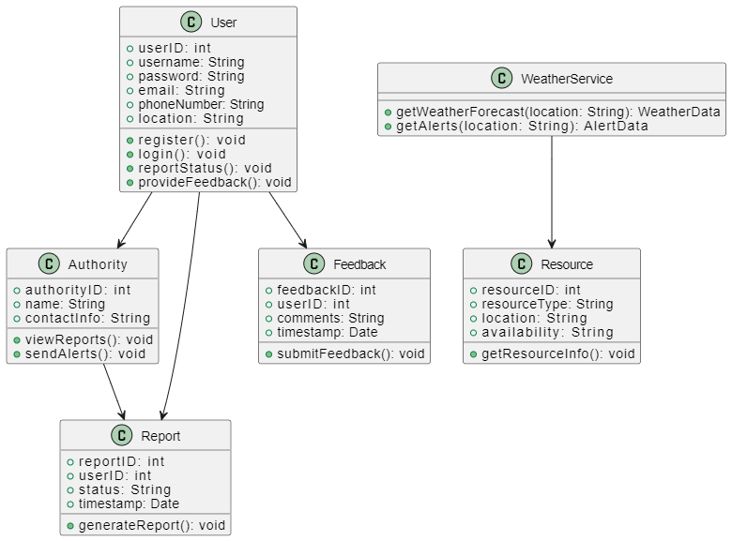
CLASS DIAGRAM

Slide 11
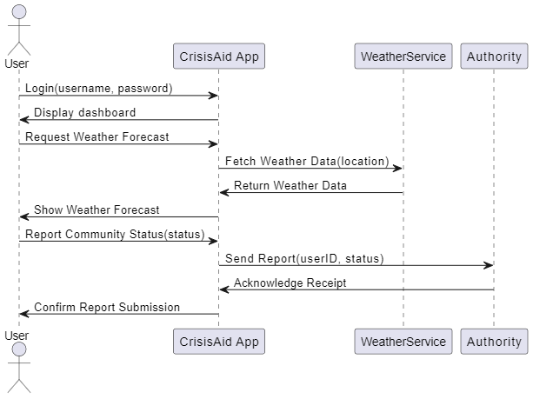
Sequence diagram

Slide 12
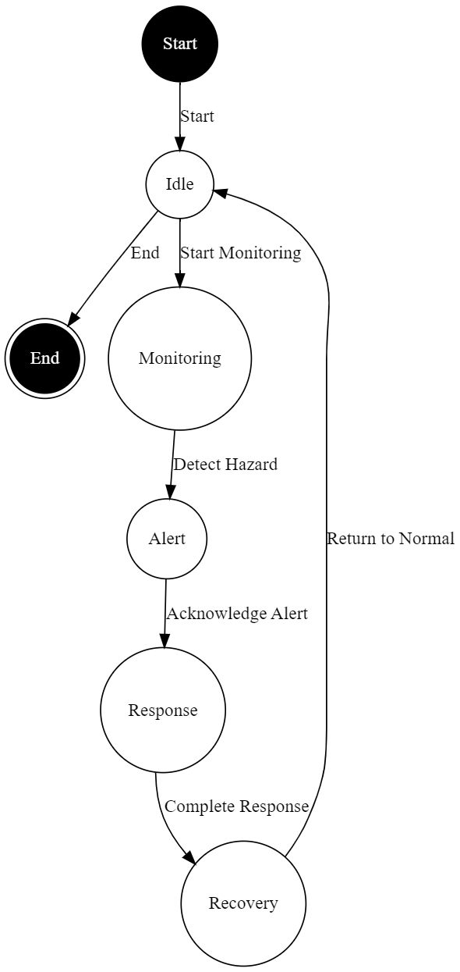
State chart diagram

Slide 13
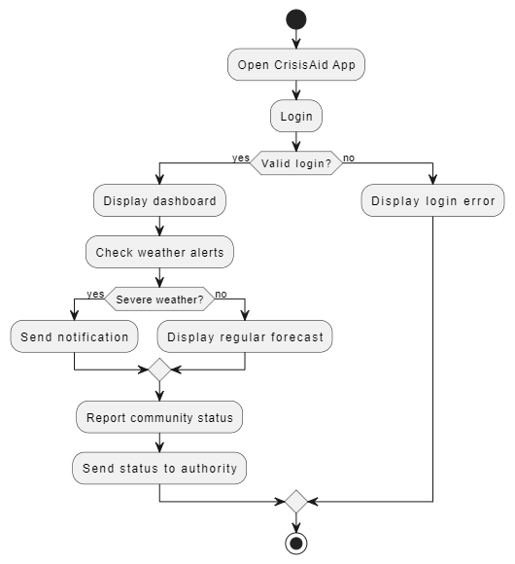
Activity diagram

Slide 14
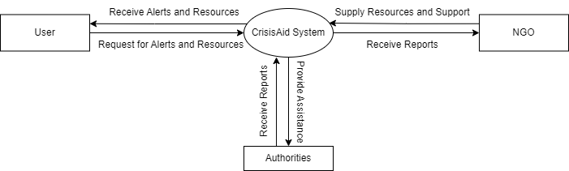
DATAFLOW DIAGRAMs
Data flow diagram level 0

Slide 15
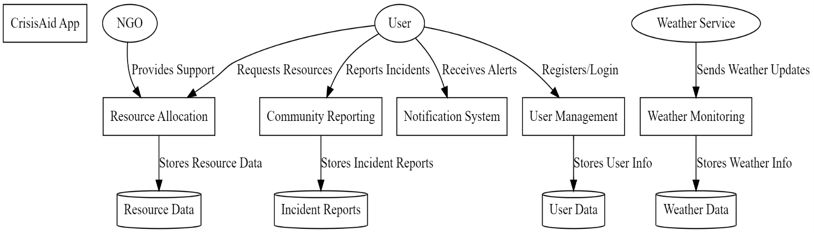
Dataflow diagram level 1

Slide 16
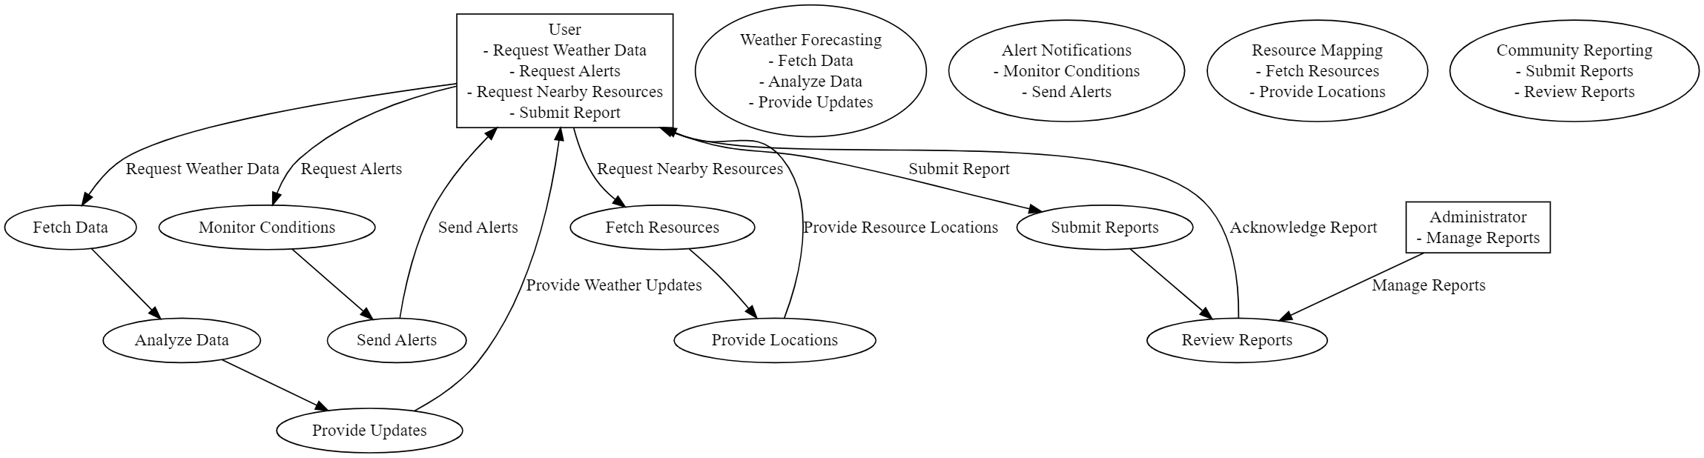
Dataflow diagram level 2

Slide 17
Module description
CrisisAid consists of 7 main modules. They are
User Management Module.
Weather Prediction Module.
Alert System Module.
Resource Mapping Module.
Community Reporting Module.
Data Integration Module.
User Feedback Module.

Slide 18
User Management Module :
This module provides an intuitive and user-friendly interface that allows users to easily navigate the app. It features quick access to critical information, including weather updates, alerts, and resources. The design prioritizes usability, ensuring that users can find the information they need during emergencies with minimal effort.

Slide 19
Weather Prediction Module :
Leveraging advanced meteorological data, this module delivers accurate real-time weather forecasts and predictions. It analyzes historical and current weather patterns to issue alerts for impending disasters, such as storms or floods, empowering users to prepare adequately and take necessary precautions.

Slide 20
Alert System Module:
The Alert System is responsible for generating and sending localized early warning notifications to users based on their geographic locations. It ensures timely communication of critical information regarding weather changes and disaster alerts, enabling users to take prompt action to safeguard their safety.

Slide 21
Resource Mapping Module:
This module integrates a mapping feature that connects users to nearby resources such as shelters, food distribution centers, and medical facilities. By providing location-based services, users can quickly find and access essential support during a disaster, facilitating efficient resource allocation.

Slide 22
Community Reporting Module:
The Community Reporting Module allows users to share real-time information about their situations during emergencies. This feature encourages community engagement and crowdsourcing, enabling users to report their needs, share updates, and assist authorities in assessing the situation for better resource deployment.

Slide 23
Data Integration Module:
This module facilitates the integration of various data sources to enhance the app's predictive capabilities. By analyzing historical data and real-time inputs, it improves the accuracy of weather predictions and resource management, supporting better decision-making during disasters.

Slide 24
User Feedback Module:
This module collects user feedback and insights regarding the app's performance and features. By analyzing this data, developers can make continuous improvements and adapt the app to better meet user needs, ensuring it remains effective in disaster management scenarios.

Slide 25
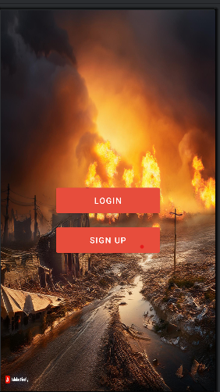
main page

Slide 26
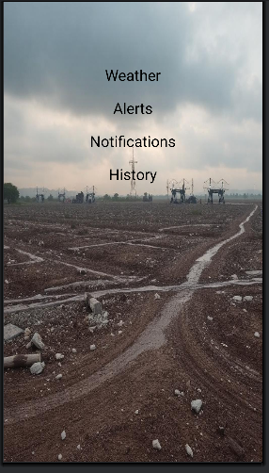
home page

Slide 27
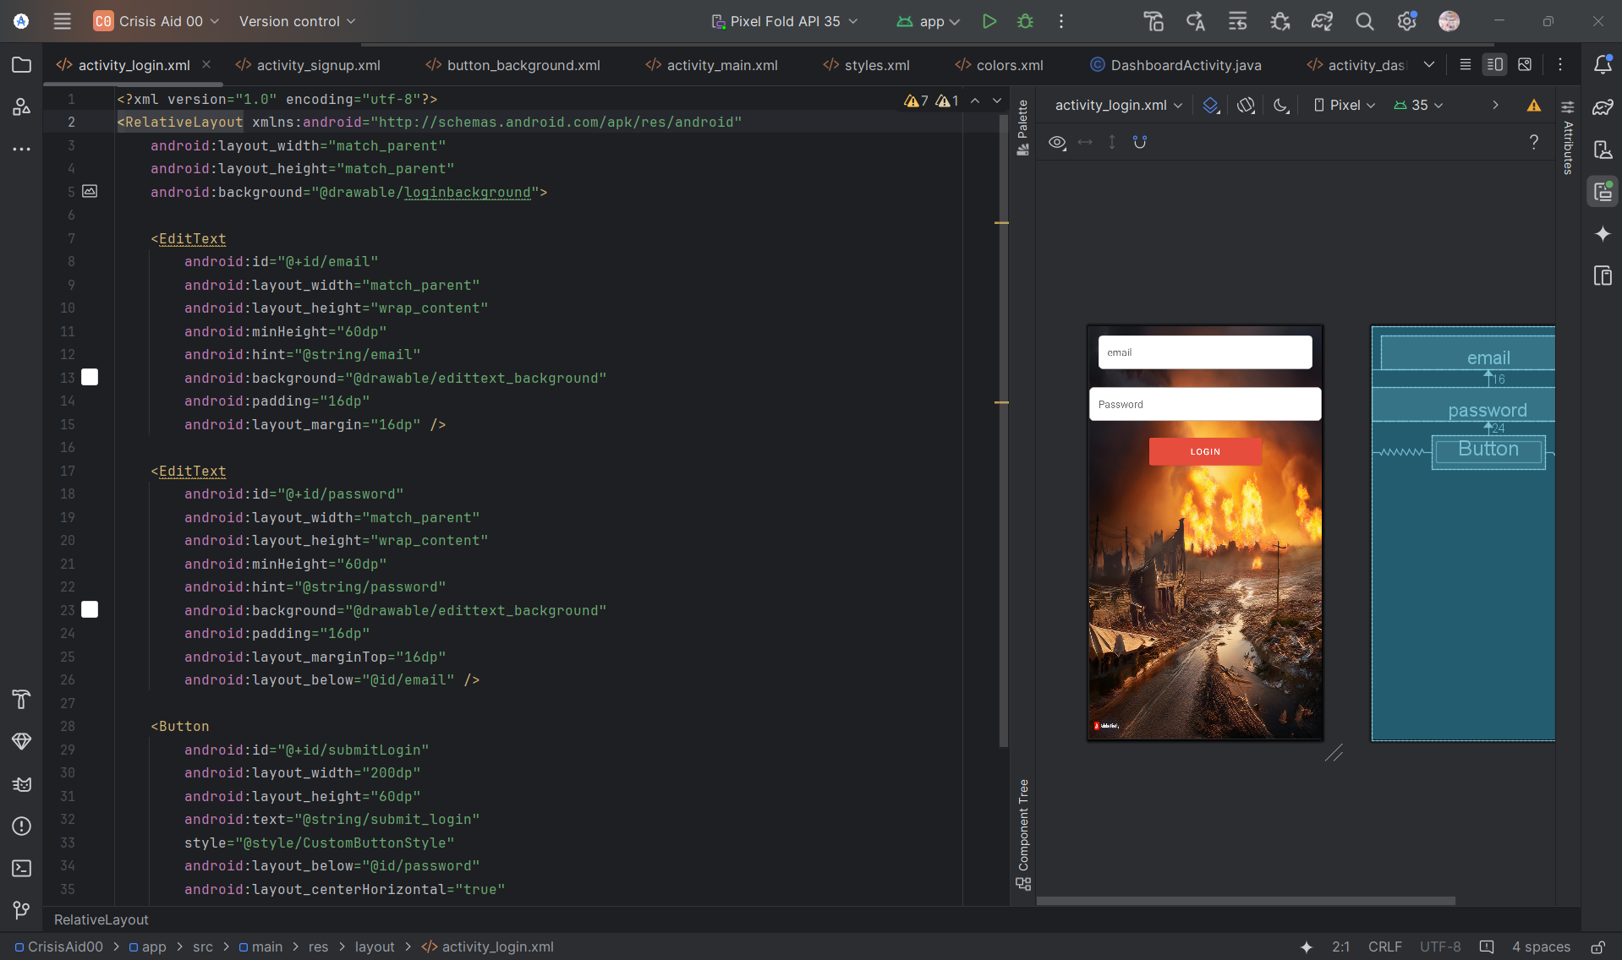
Sample outlook of project

Slide 28
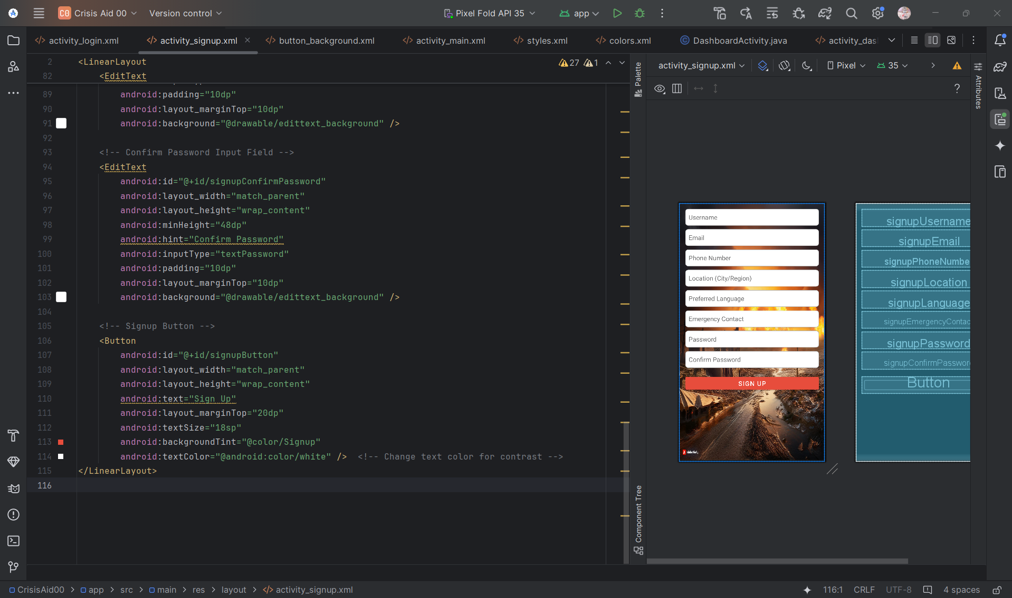
Sample outlook of project

Slide 29
CONCLUSION
CrisisAid is an innovative disaster management application that effectively addresses the limitations of existing systems by providing essential features for real-time weather predictions, localized early warning alerts, and streamlined access to resources. Its user-centered design not only enhances community preparedness and response during emergencies but also fosters active engagement and collaboration among users. By integrating advanced technology and facilitating community reporting, CrisisAid empowers individuals to make informed decisions that can save lives and reduce the impact of disasters. As the application continues to evolve through user feedback and technological advancements, it holds the potential to significantly improve disaster management practices, ultimately contributing to safer and more resilient communities.

Slide 30
Future work
CrisisAid aims to continually evolve by integrating enhanced predictive analytics through advanced machine learning algorithms for more accurate weather forecasts and disaster predictions. Future enhancements include the incorporation of Internet of Things (IoT) technology to collect real-time environmental data from sensors, expanding language support to cater to diverse user populations, and developing educational modules for disaster preparedness. Additionally, collaborating with local authorities will improve resource allocation and verification of shelter information. Implementing offline functionality will ensure access to critical features during network outages, while a robust feedback mechanism will facilitate continuous improvement based on user experiences. The introduction of community engagement features, customizable alerts, and interactive data visualization tools will further empower users, making CrisisAid a more effective and user-friendly disaster management solution.

Slide 31
references
[1] SoYoung Park;MinKyo Youm;JunWoo Lee, 3D disaster management a study on utilization of smart CCTV-based 3D geo-spatial information, 2015 2nd International Conference on Information and Communication Technologies for Disaster Management (ICT-DM)
[2] Lai Wei; Hong Chen, Emergent Management for Consumable Industry Chains after Natural Disasters, 2009 International Conference on Management of e-Commerce and e-Government
[3] Xinliang Ye; Jiahong Wen; Peiyi Ding, Integrated natural disasters risk management in tourism destination—A case study of 5.12 WenChuan Earthquake, 2010 IEEE International Conference on Management of Innovation & Technology.
[4] Yida Fan;Wei Wu;Ming Liu;Suju Li;Haixia He;Yang Shuo, Capacity analysis of GF—4 on the disaster management, 2016 IEEE International Geoscience and Remote Sensing Symposium (IGARSS).
[5] Ko Ko Lwin;Yoshihide Sekimoto;Wataru Takeuchi;Koji Zettsu, City Geospatial Dashboard: IoT and Big Data Analytics for Geospatial Solutions Provider in Disaster Management, 2019 International Conference on Information and Communication Technologies for Disaster Management (ICT-DM)

Slide 32
THANK YOU

